Slide 1
Run MPI program on chameleon

Slide 2
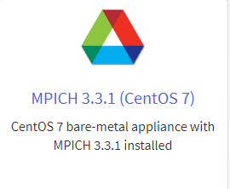
The appliance in use
The appliance in use is MPICH3.3.1 (CentOS 7). For the other configuration parts, You can use the same as programming assignment 1.

Slide 3
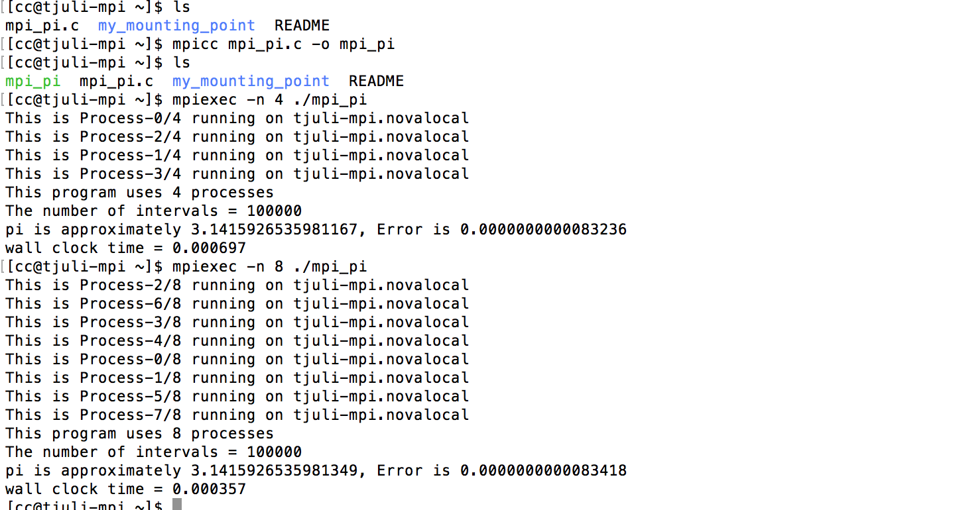
Run MPI program on the instance
Mpi_pi.c is a mpi source program.
We use mpicc mpi_ pi.c – o mpi_pi for compilation and get the executable file mpi_pi.
Then we use mpiexec –n 4(the number of processes in use) ./mpi_pi(executable file) to run it.

